Slide 1
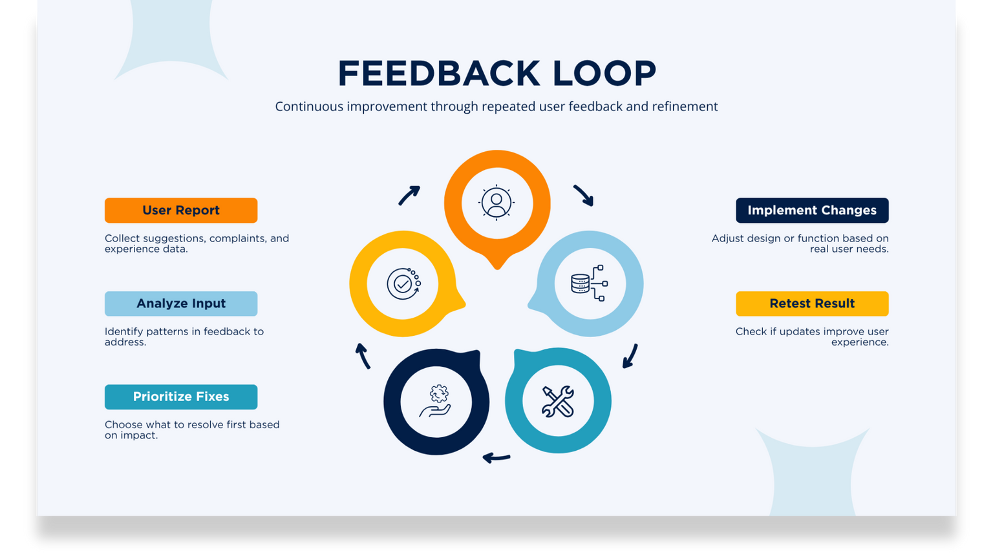
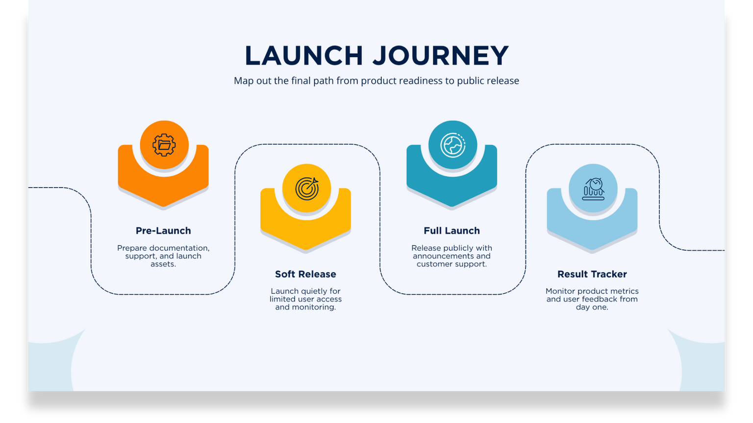
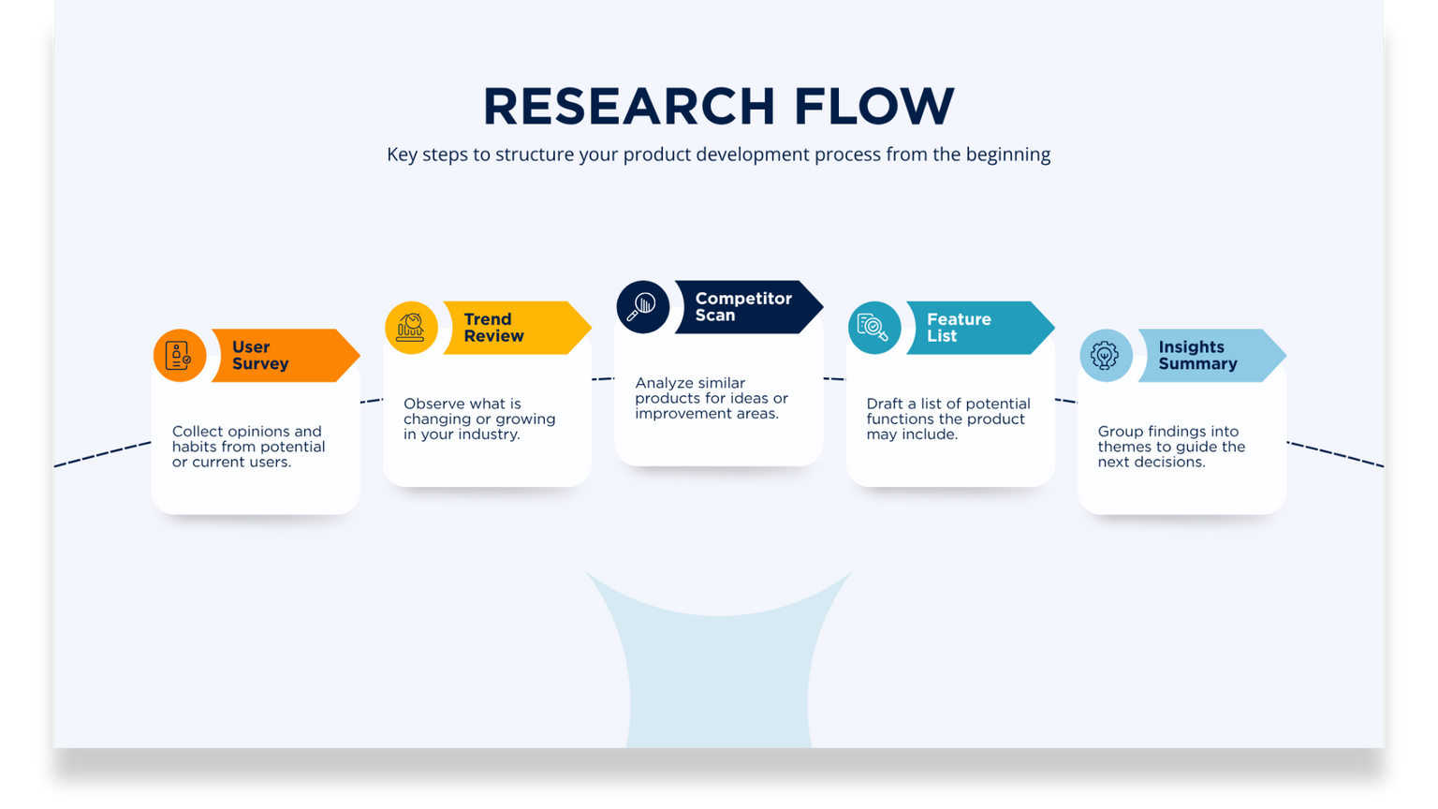
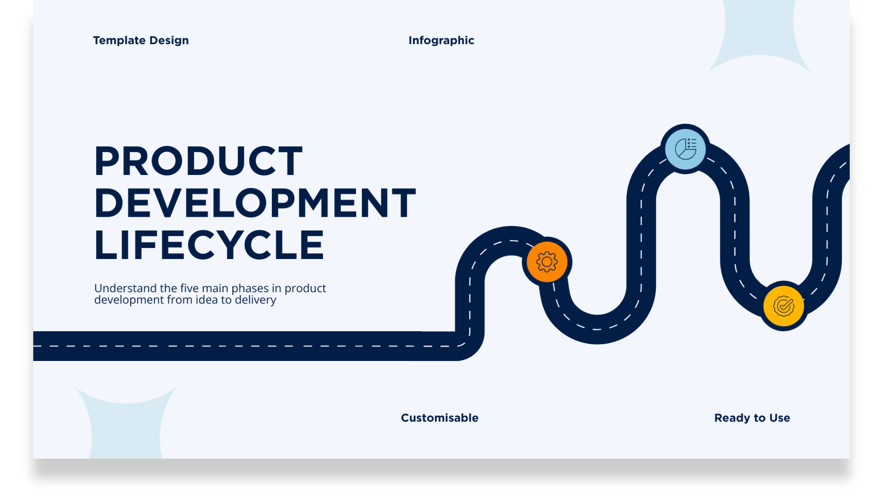
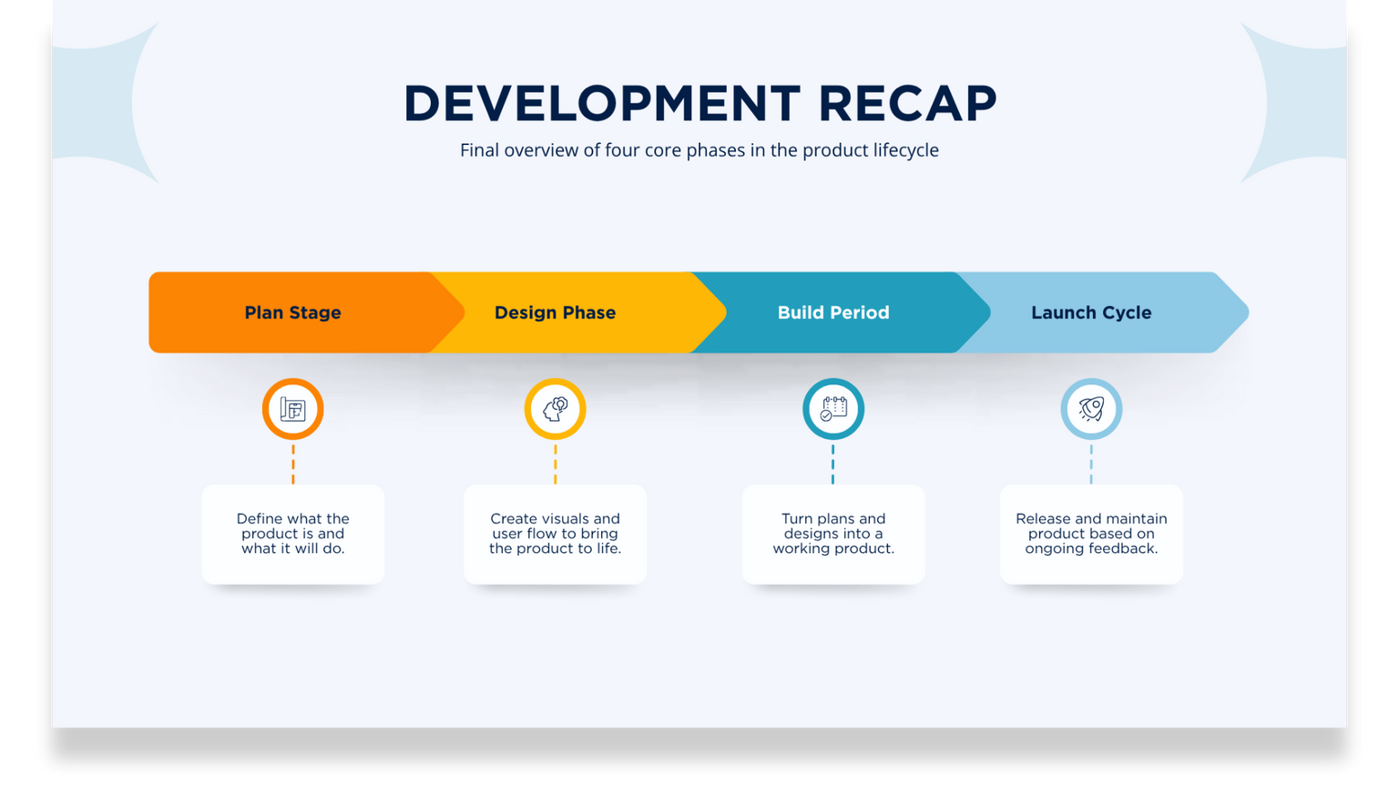
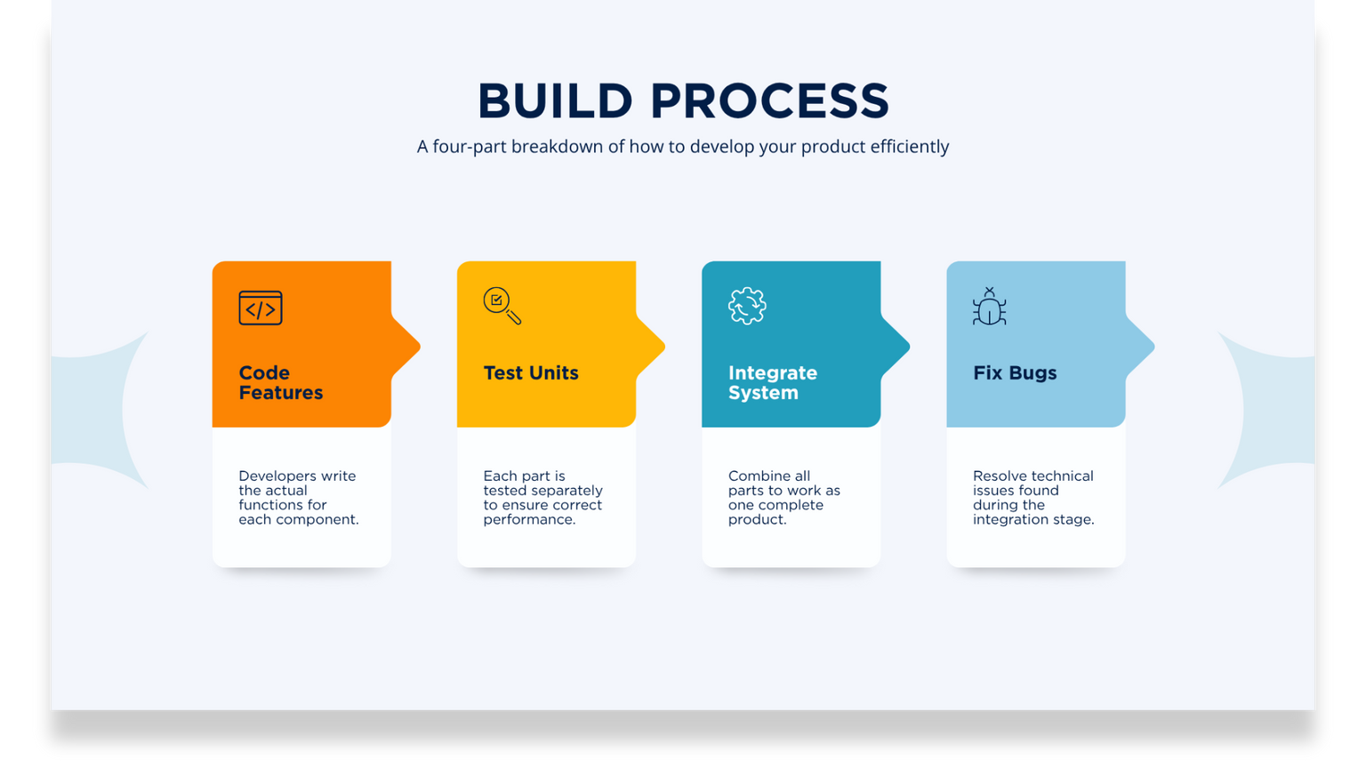
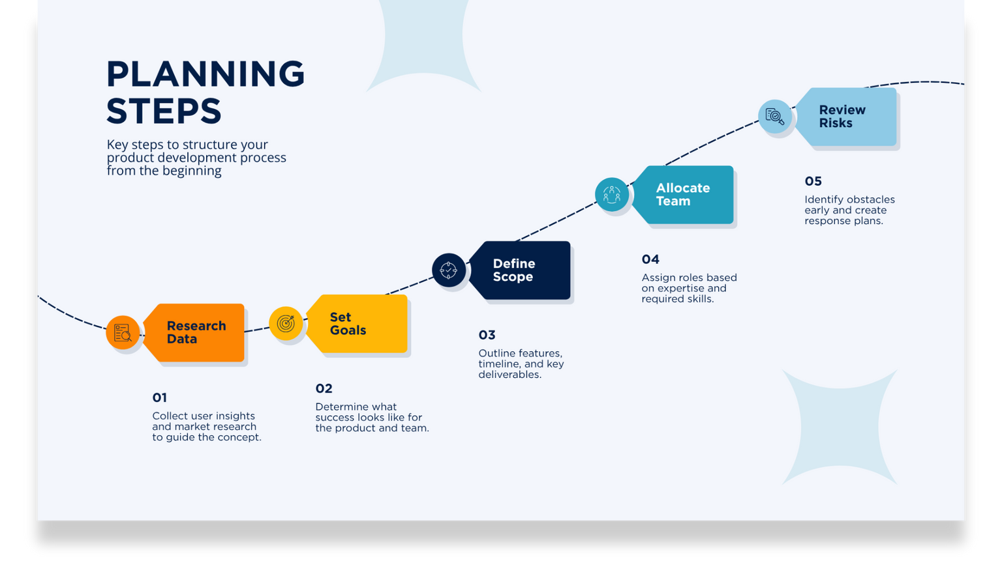
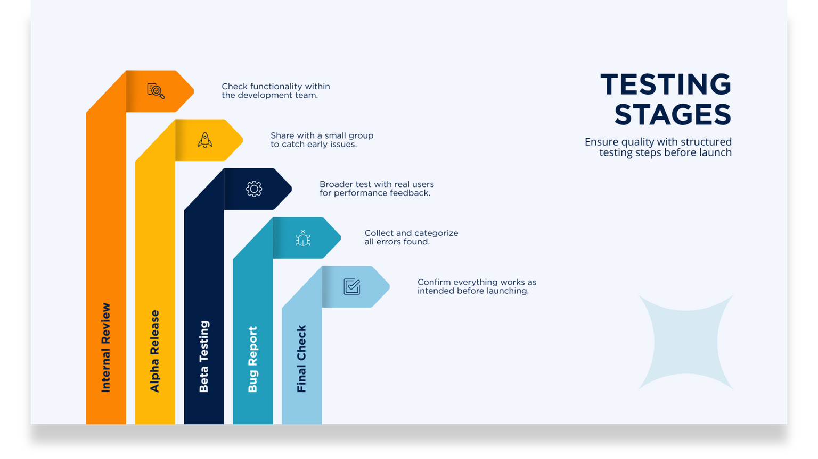
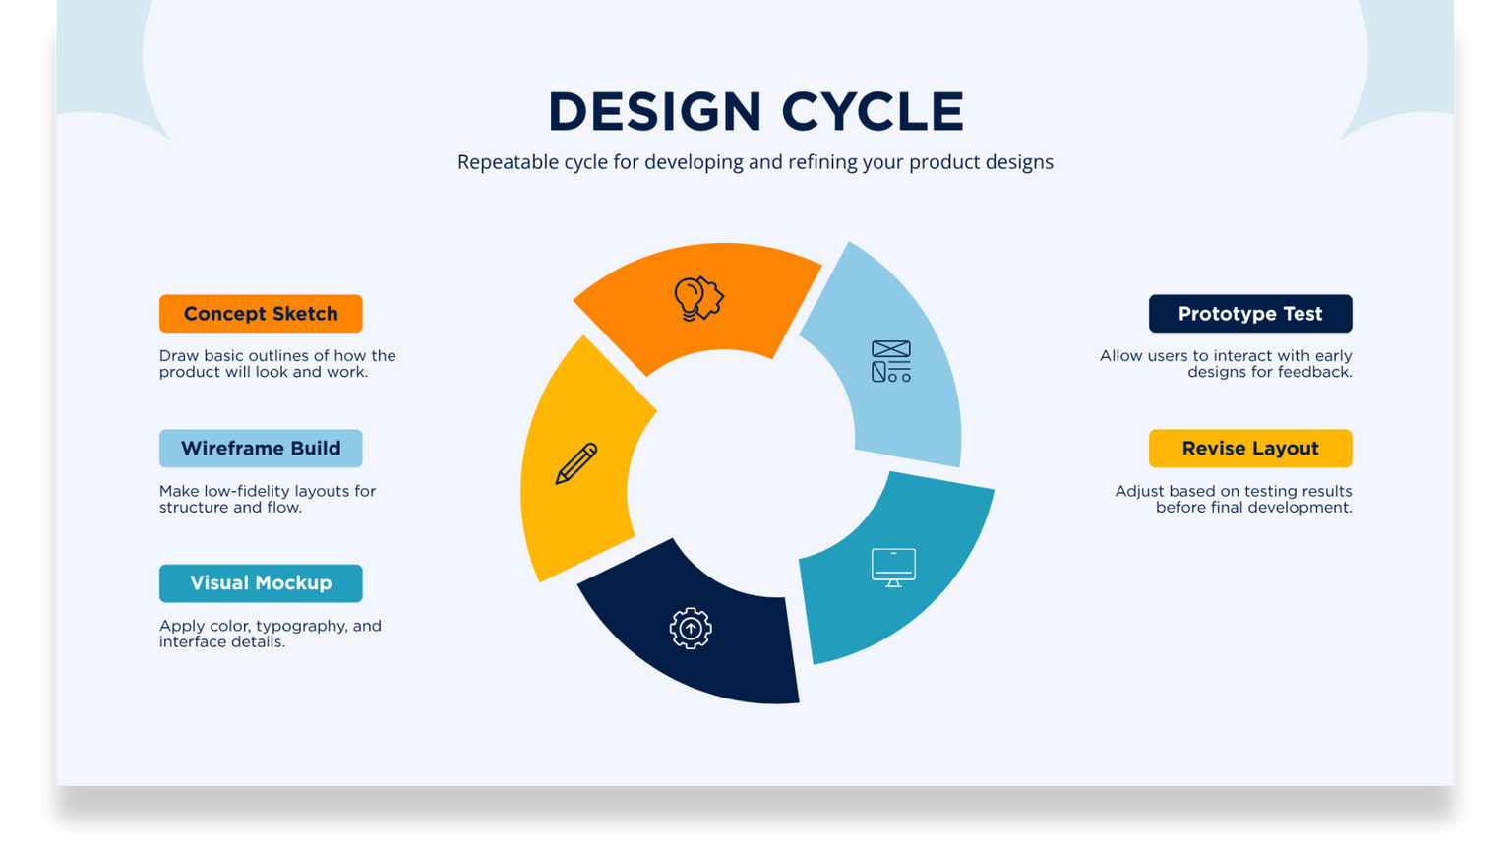

Slide 2

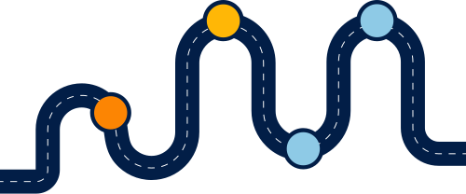
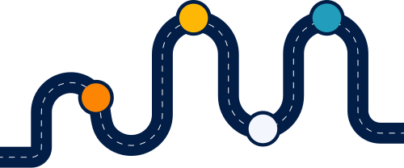

LIFECYCLE OVERVIEW
Planning Phase
Build Stage
Define scope, goals, budget, and development timeline.
Develop and test product features in multiple iterations.
Understand the five main phases in product development from idea to delivery
Idea Stage
Design Phase
Launch Time
Identify product opportunities based on user needs or market gaps.
Create wireframes, mockups, and early product visuals.
Release product and begin gathering user data and feedback.

Slide 3



PLANNING STEPS
Review Risks
Key steps to structure your product development process from the beginning
Allocate Team
05
Identify obstacles early and create response plans.
Define Scope
04
Assign roles based on expertise and required skills.
Research Data
Set Goals
03
Outline features, timeline, and key deliverables.
01
02
Collect user insights and market research to guide the concept.
Determine what success looks like for the product and team.

Slide 4


RESEARCH FLOW
Key steps to structure your product development process from the beginning
Competitor Scan
Trend Review
Feature List
User Survey
Insights Summary
Analyze similar products for ideas or improvement areas.
Observe what is changing or growing in your industry.
Draft a list of potential functions the product may include.
Collect opinions and habits from potential or current users.
Group findings into themes to guide the next decisions.

Slide 5

DESIGN CYCLE
Repeatable cycle for developing and refining your product designs
Concept Sketch
Prototype Test
Draw basic outlines of how the product will look and work.
Allow users to interact with early designs for feedback.
Wireframe Build
Revise Layout
Make low-fidelity layouts for structure and flow.
Adjust based on testing results before final development.
Visual Mockup
Apply color, typography, and interface details.

Slide 6
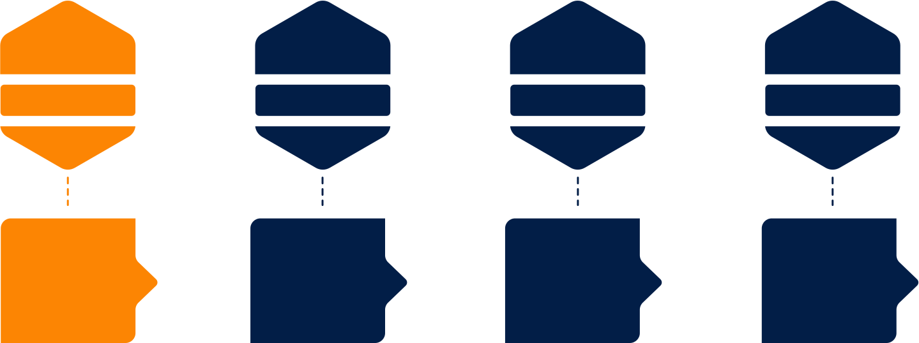
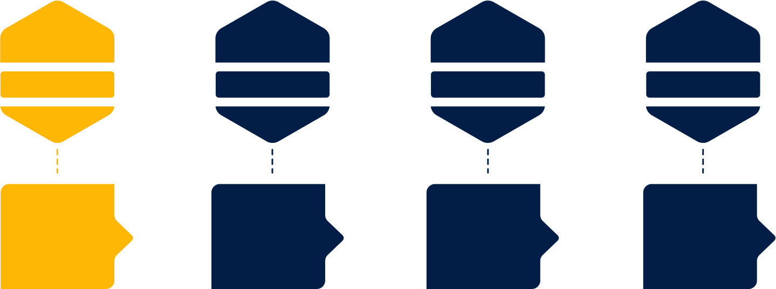
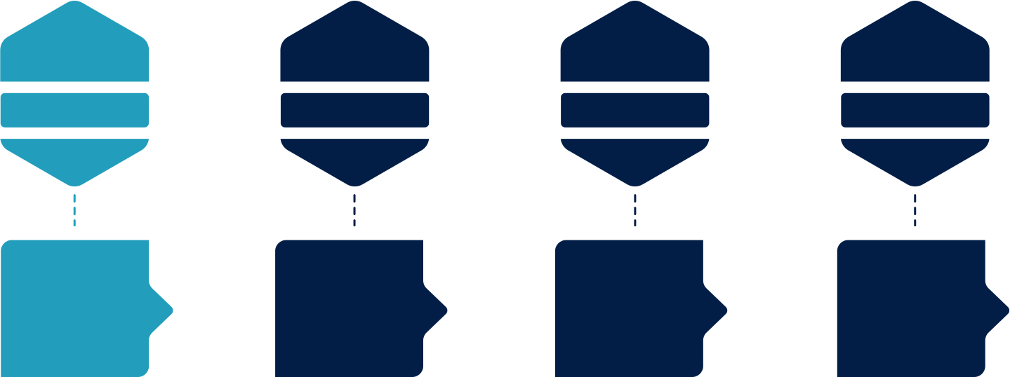
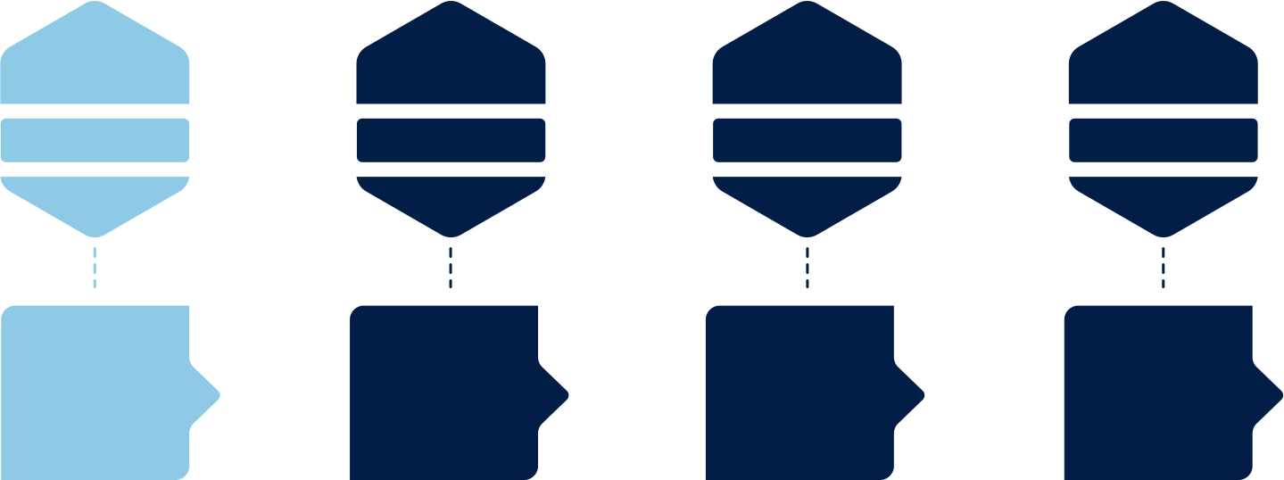

BUILD PROCESS
A four-part breakdown of how to develop your product efficiently
Code Features
Test Units
Integrate System
Fix Bugs
Developers write the actual functions for each component.
Each part is tested separately to ensure correct performance.
Combine all parts to work as one complete product.
Resolve technical issues found during the integration stage.

Slide 7
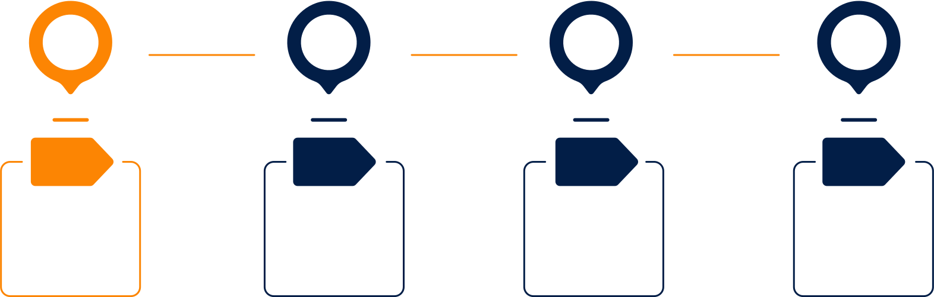

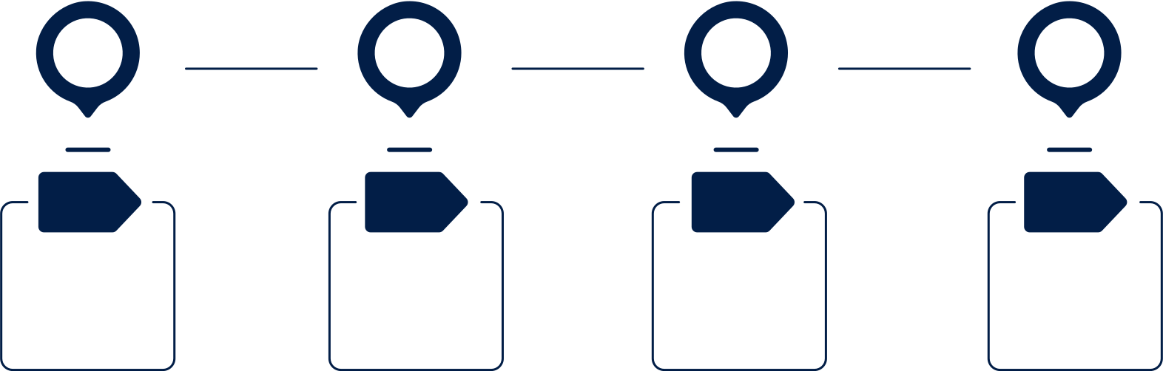
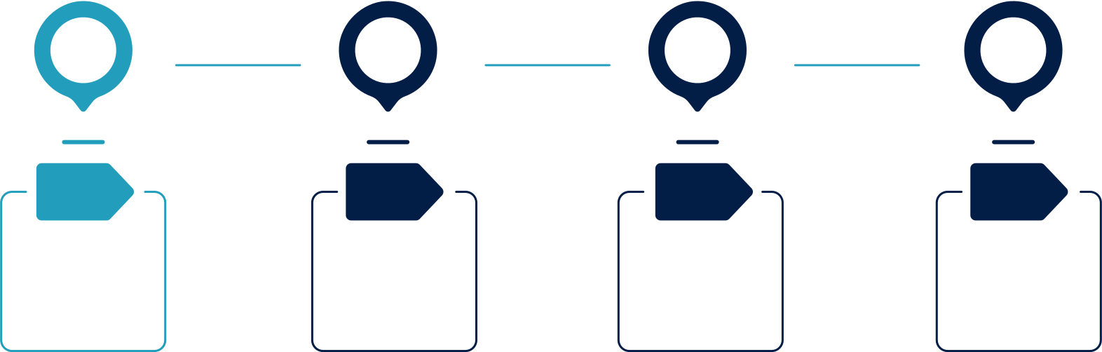
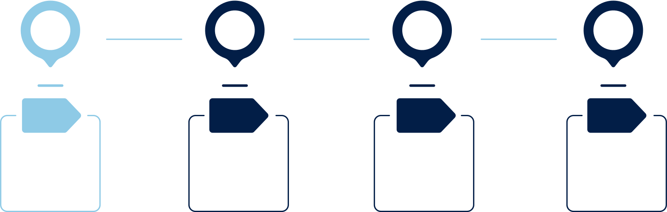
TESTING STAGES
Check functionality within the development team.
Share with a small group to catch early issues.
Ensure quality with structured testing steps before launch
Broader test with real users for performance feedback.
Collect and categorize all errors found.
Confirm everything works as intended before launching.
Internal Review
Alpha Release
Beta Testing
Bug Report
Final Check

Slide 8



FEEDBACK LOOP
Continuous improvement through repeated user feedback and refinement
User Report
Implement Changes
Collect suggestions, complaints, and experience data.
Adjust design or function based on real user needs.
Analyze Input
Retest Result
Identify patterns in feedback to address.
Check if updates improve user experience.
Prioritize Fixes
Choose what to resolve first based on impact.

Slide 9





LAUNCH JOURNEY
Map out the final path from product readiness to public release
Pre-Launch
Full Launch
Prepare documentation, support, and launch assets.
Release publicly with announcements and customer support.
Soft Release
Result Tracker
Launch quietly for limited user access and monitoring.
Monitor product metrics and user feedback from day one.

Slide 10


GROWTH ROADMAP
Long-term roadmap for growing and evolving your product post-launch
Feature Requests
Market Expansion
Gather and assess user suggestions for added functions.
Grow to new audiences or platforms after scaling.
User Onboarding
Version Updates
Ongoing Support
Simplify new user experience with guides and support.
Roll out new features based on user need and stability.
Provide help channels and respond to new issues fast.

Slide 11
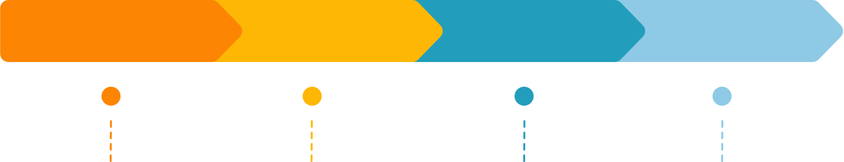


DEVELOPMENT RECAP
Final overview of four core phases in the product lifecycle
Plan Stage
Design Phase
Build Period
Launch Cycle
Define what the product is and what it will do.
Create visuals and user flow to bring the product to life.
Turn plans and designs into a working product.
Release and maintain product based on ongoing feedback.

